Slide 1
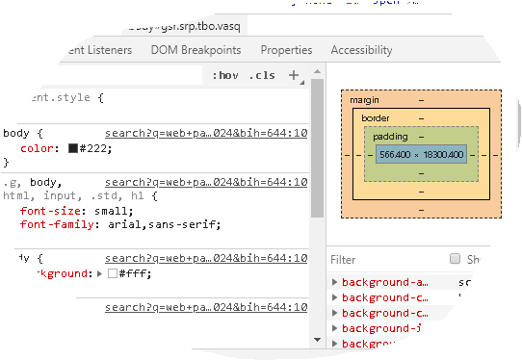
පසුගිය විභාග බහුවරණ ප්‍රශ්න
Web Page Designing
Anton Gajasinghe
PG Diploma For IT – University of Peradeniya
Bsc – University of peradeniya
Email – antongajasinghe@gmail.com Tel - 0714466533

Slide 2
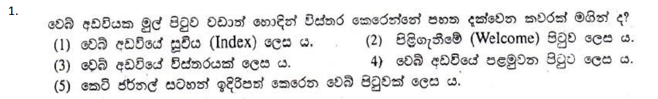

Slide 3
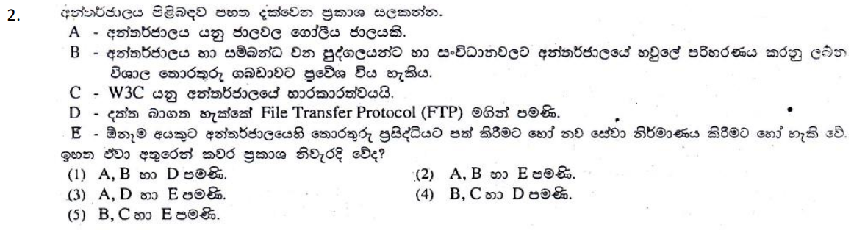

Slide 4
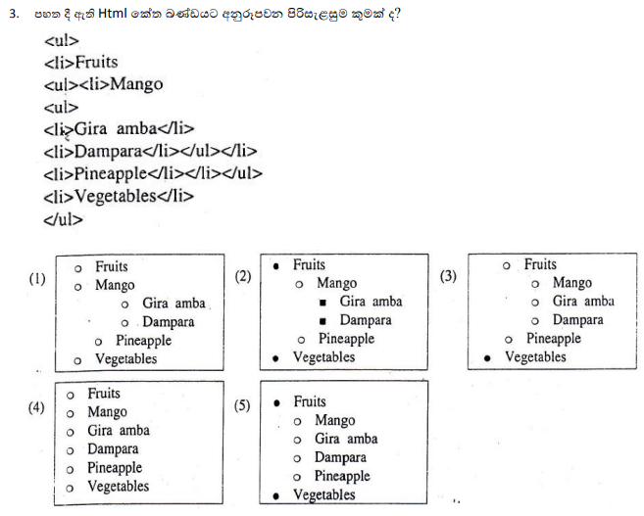

Slide 5
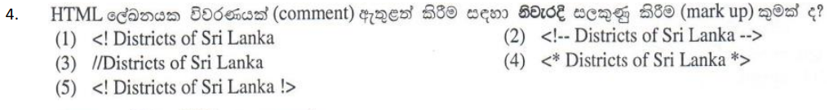

Slide 6
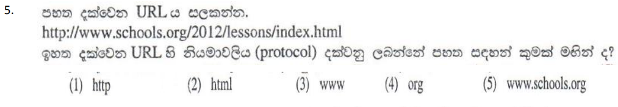

Slide 7
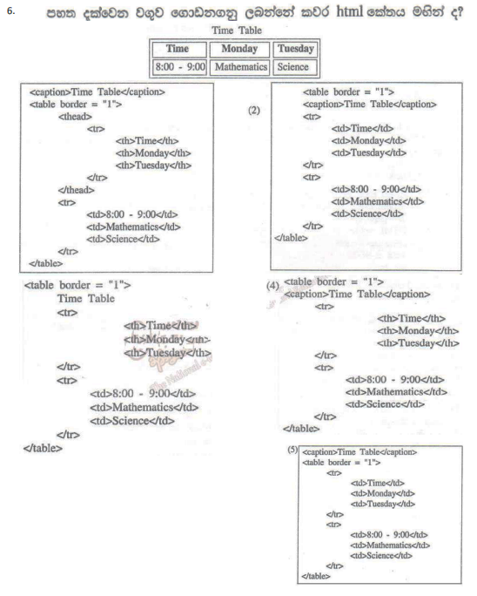

Slide 8
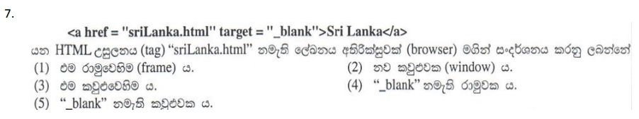
Value | Description
_blank | Opens the linked document in a new window or tab
_self | Opens the linked document in the same frame as it was clicked (this is default)
_parent | Opens the linked document in the parent frame
_top | Opens the linked document in the full body of the window
framename | Opens the linked document in a named frame

Slide 9
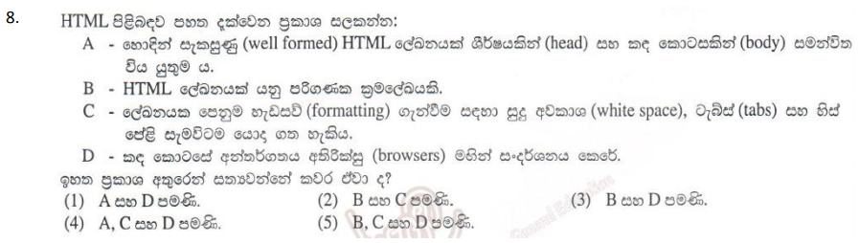

Slide 10
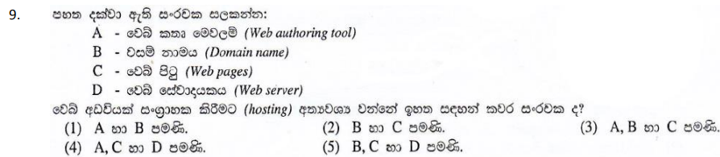
Web authoring tools are used to create Web content, and cover a wide range of software programs you can download to your computer or access online. The World Wide Web Consortium, or W3, issues guidelines for web authoring tools that create a basic industry standard for web accessibility.

Slide 11
Types of web authoring tools
Text Editors -
They allow users to write and edit HTML, CSS, and JavaScript codes directly. Examples of text editors include Notepad++, Sublime Text, and Visual Studio Code.
WYSIWYG Editors: WYSIWYG (What You See Is What You Get)
provide a visual interface for designing web pages. Users can drag and drop elements onto a canvas and customize them using an intuitive UI.
Adobe Dreamweaver, Microsoft Expression Web, and WordPress
CMS Content Management Systems
enable users to create and manage website content easily.
pre-designed templates and themes, as well as plugins and extensions
WordPress, Joomla, and Drupal

Slide 13
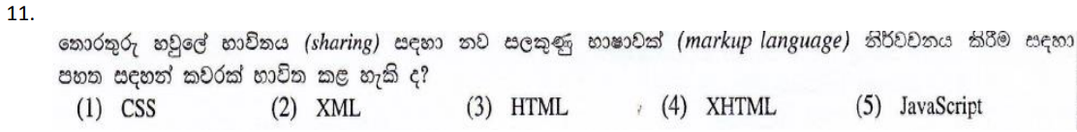
XML - eXtensible Markup Language
XHTML - Extensible HyperText Markup Language

Slide 14
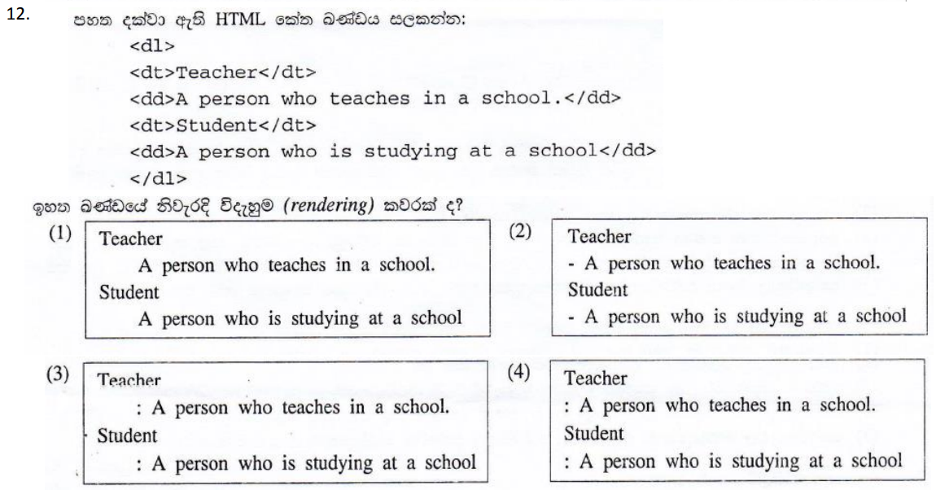
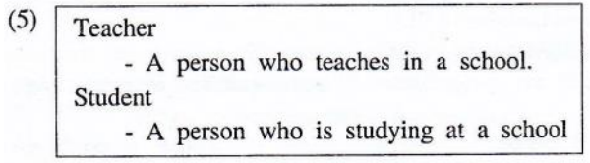

Slide 15
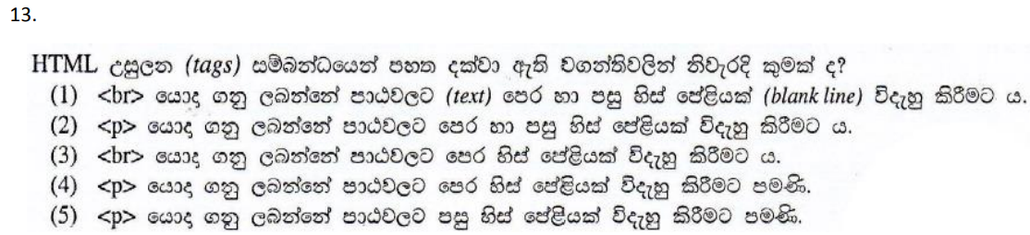

Slide 16
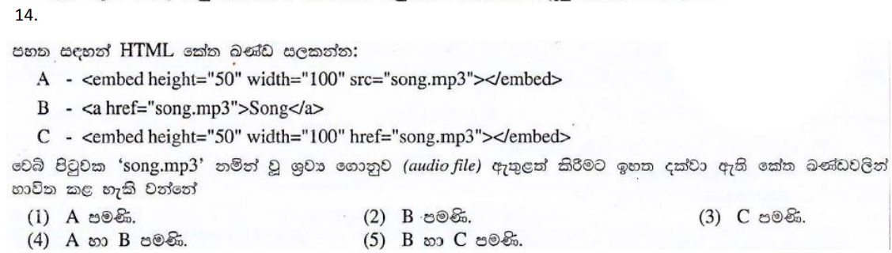

Slide 17
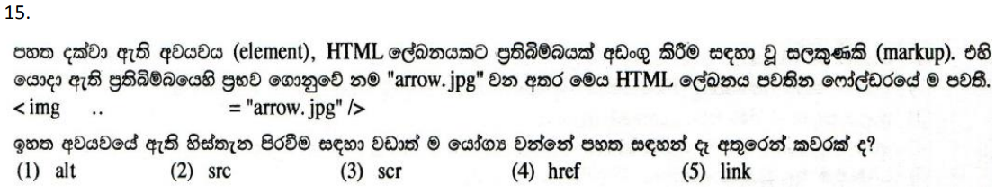

Slide 18
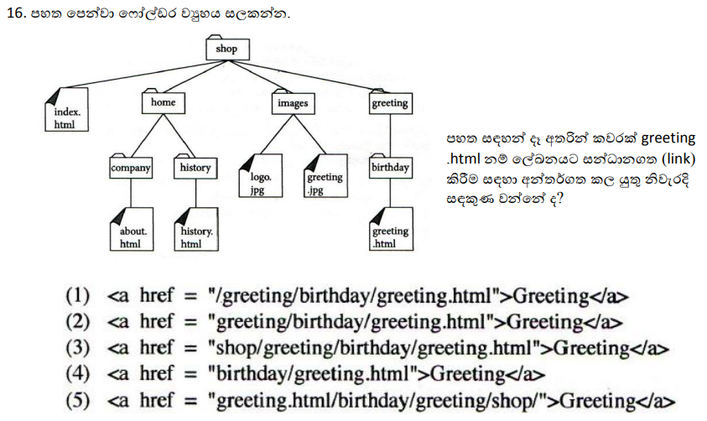

Slide 19
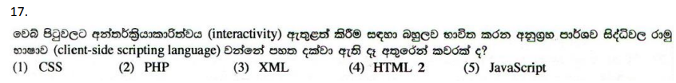

Slide 20
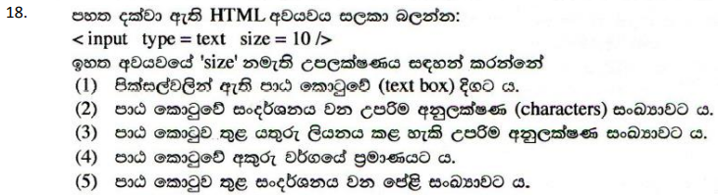

Slide 21
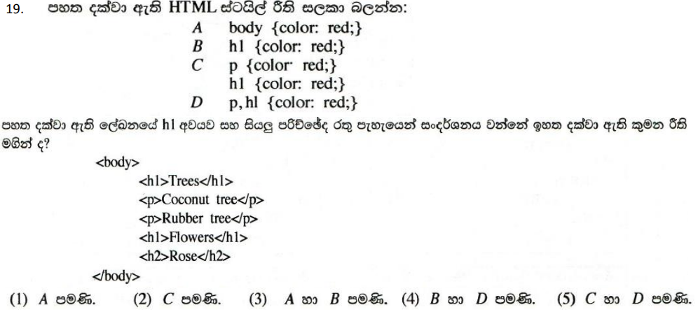

Slide 22
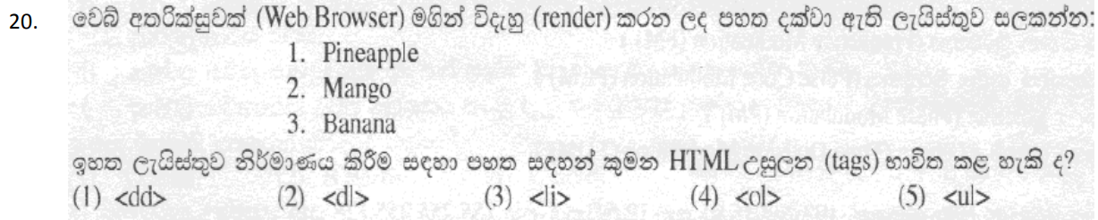

Slide 23
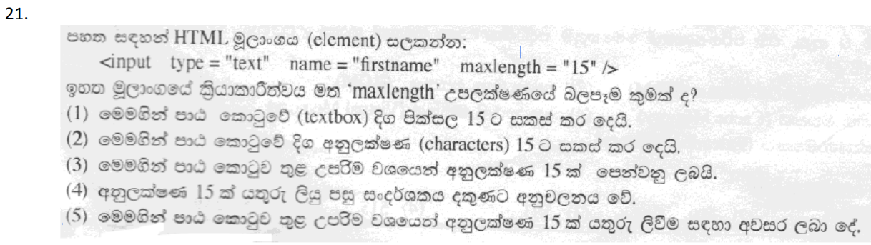

Slide 24
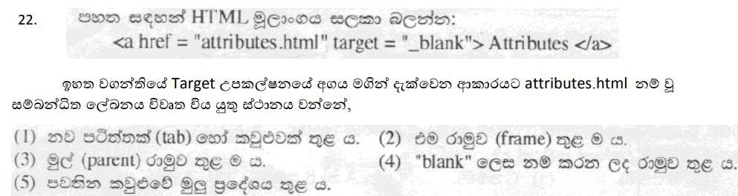

Slide 25
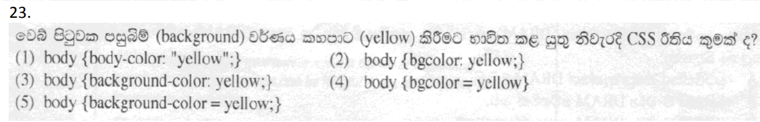

Slide 26
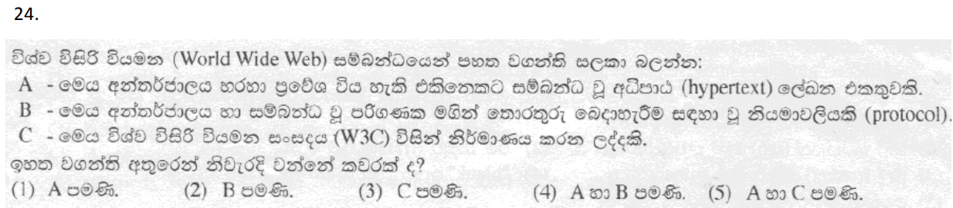

Slide 27
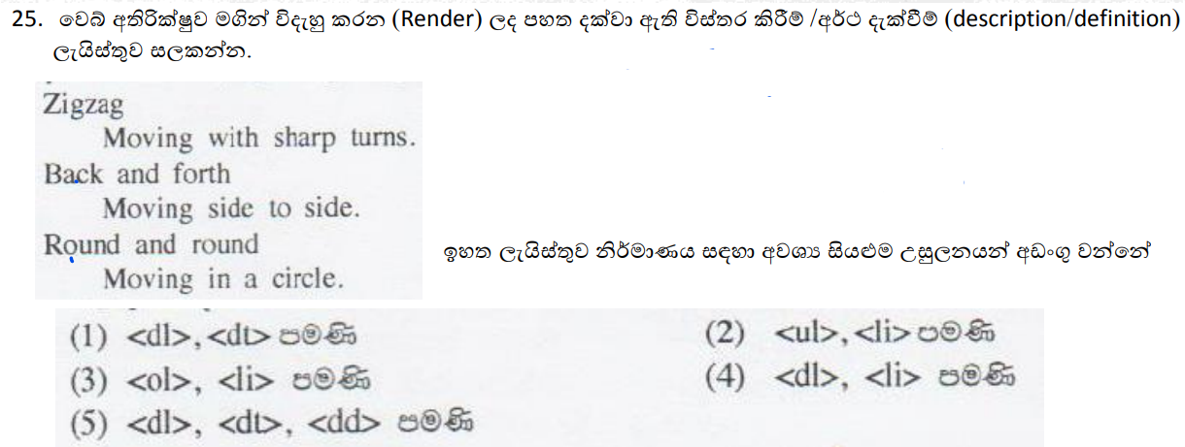

Slide 28
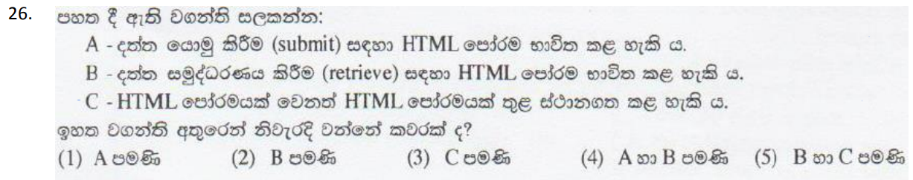

Slide 29
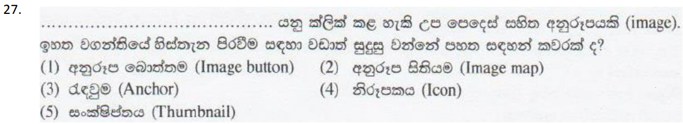

Slide 30
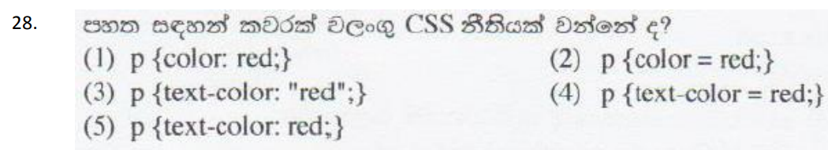

Slide 31
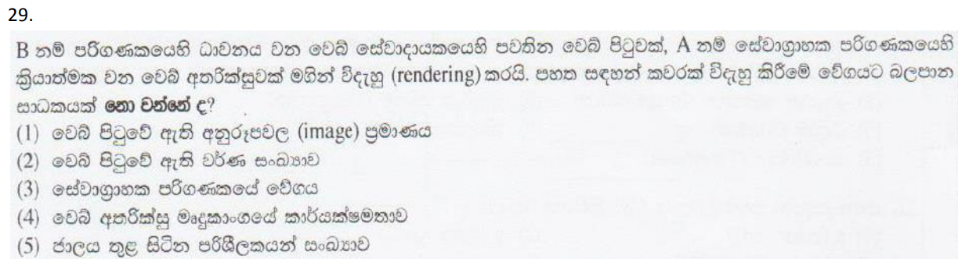

Slide 32
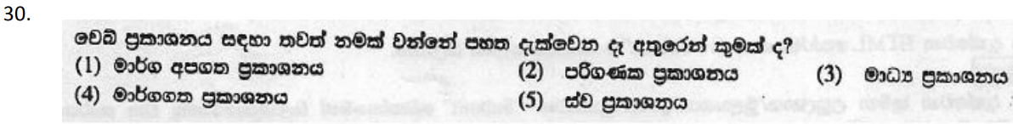

Slide 33
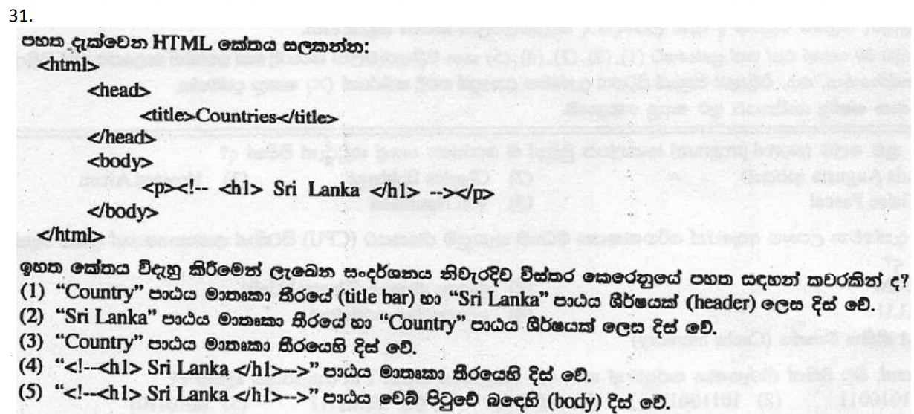

Slide 34
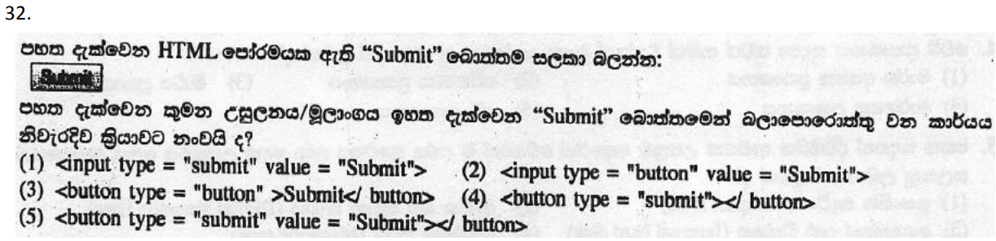

Slide 35
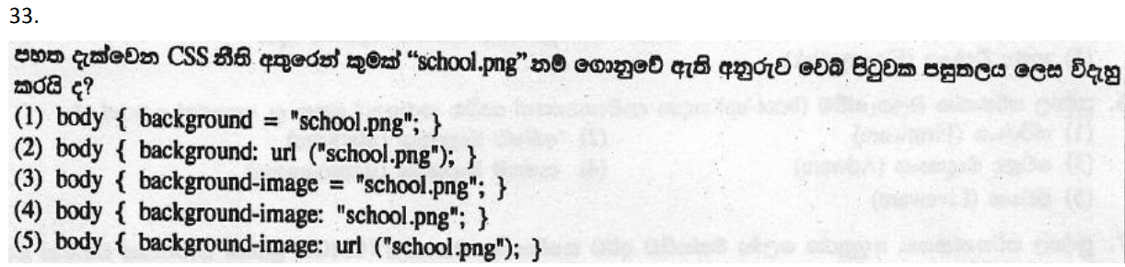

Slide 36
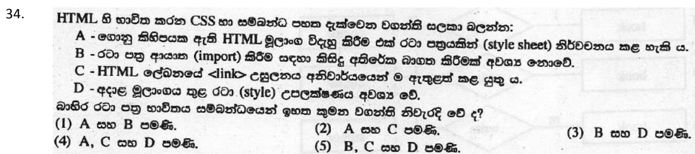

Slide 38
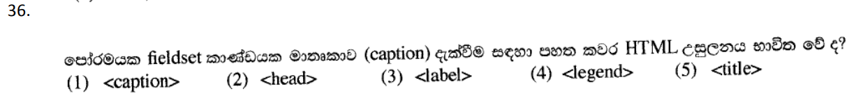

Slide 39
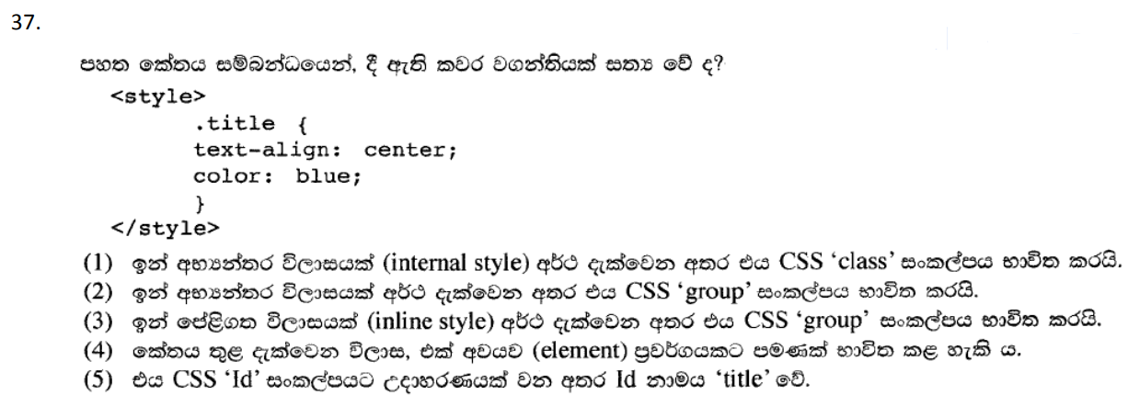

Slide 40
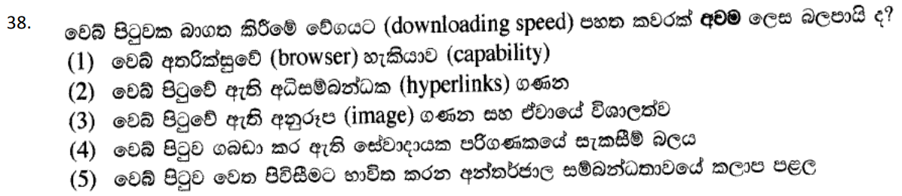

Slide 41
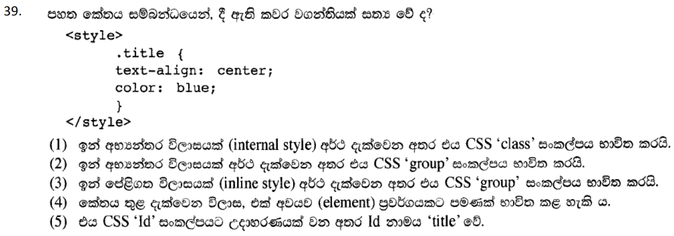

Slide 42
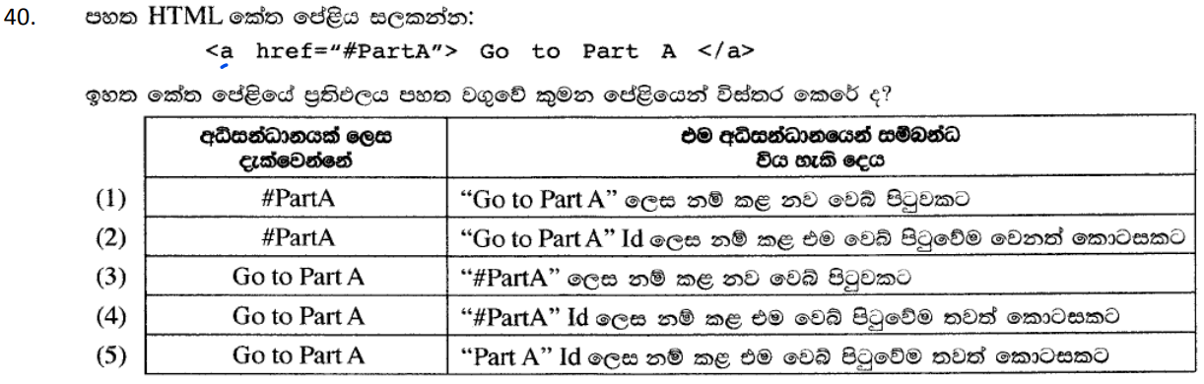

Slide 43
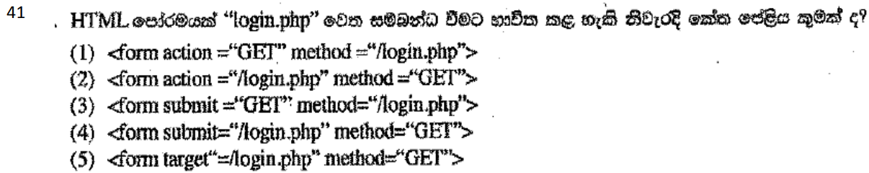

Slide 44
